Slide 1
Blood vessels

Slide 2
Blood Vessels
Blood is carried in a closed system of vessels that begins and ends at the heart
The three major types of vessels are arteries, capillaries, and veins
Arteries carry blood away from the heart, veins carry blood toward the heart
Capillaries contact tissue cells and are the site of exchange

Slide 3
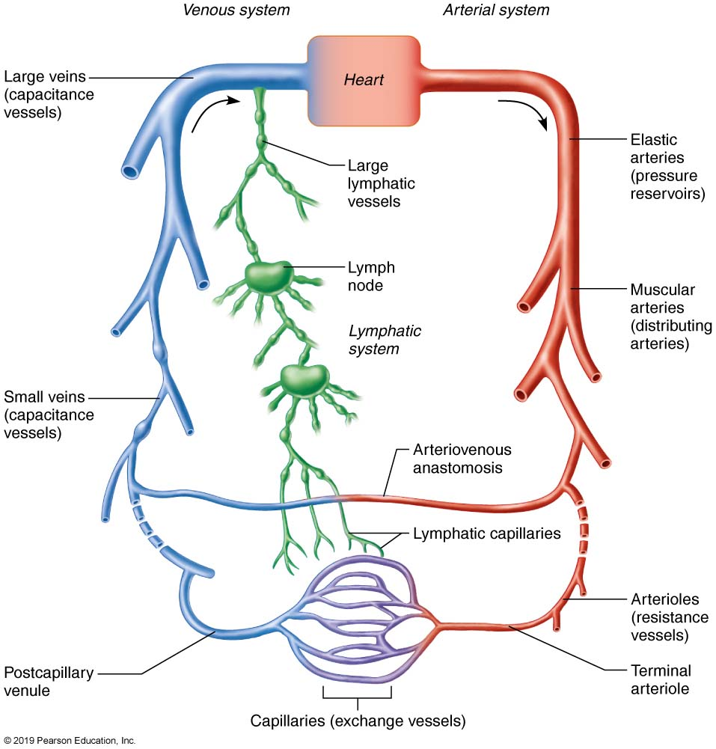
The relationship of blood vessels to each other and to lymphatic vessels.

Slide 4
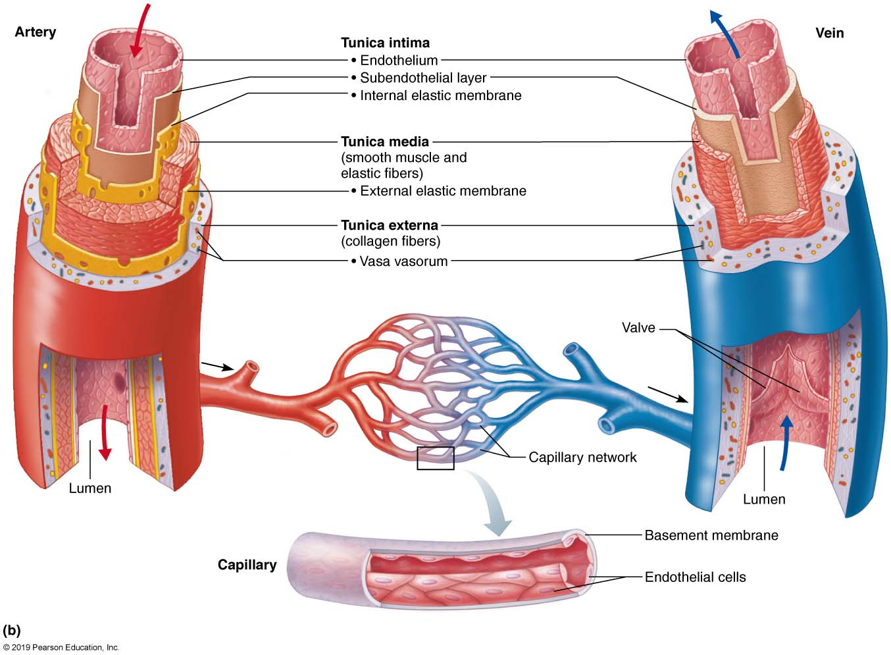
Generalized Structure of Blood Vessels
Figure 19.1b

Slide 5
Tunics
Tunica interna (tunica intima)
Endothelial layer that lines the lumen of all vessels
Continuous with endocardium
Slick surface reduces friction
Tunica media
Smooth muscle and elastic fiber layer, regulated by sympathetic nervous system
Controls vasoconstriction/vasodilation of vessels

Slide 6
Tunics (3rd layer)
Tunica externa (tunica adventitia)
Collagen fibers that protect and reinforce vessels
Larger vessels contain vasa vasorum

Slide 7
Blood Vessel Types
Arteries
Arterioles
Capillaries
Venules
Veins

Slide 8
Elastic (Conducting) Arteries
Thick-walled arteries near the heart; the aorta and its major branches
Large lumen allow low-resistance conduction of blood
Contain elastin in all three tunics
Withstand and smooth out large blood pressure fluctuations
Serve as pressure reservoirs

Slide 9
Muscular (Distributing) Arteries and Arterioles
Muscular arteries – distal to elastic arteries; deliver blood to body organs
Have thick tunica media with more smooth muscle
Active in vasoconstriction
Arterioles – smallest arteries; lead to capillary beds
Control flow into capillary beds via vasodilation and constriction

Slide 10
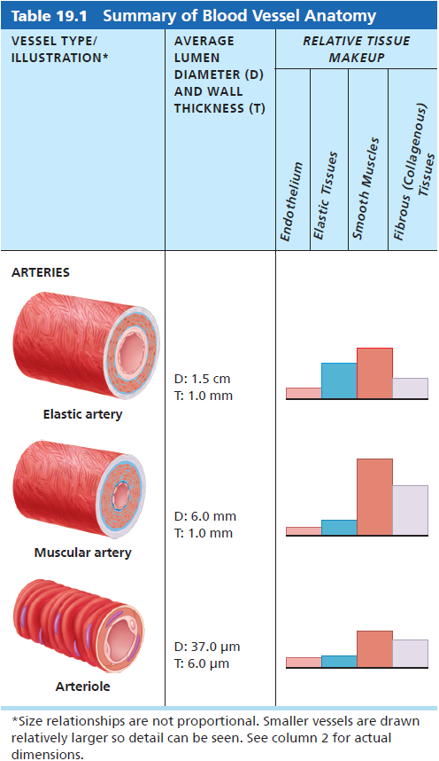
Summary of Blood Vessel Anatomy

Slide 11
Capillaries
Capillaries are the smallest blood vessels
Walls consisting of a thin tunica interna, one cell thick
Allow only a single RBC to pass at a time
Pericytes: spider-shaped stem cells help stabilize capillary walls, control permeability, and play a role in vessel repair
Supply almost every cell, except for cartilage, epithelia, cornea, and lens of eye
There are three structural types of capillaries: continuous, fenestrated, and sinusoids

Slide 12
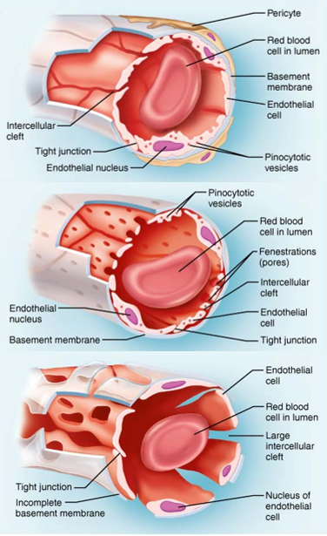
Types of Capillaries
Continuous capillaries
intercellular clefts are gaps between neighboring cells
Skeletal/smooth, CT, brain and lungs
Fenestrated capillaries
plasma membranes have many holes
kidneys, small intestine, choroid plexuses, & endocrine glands
Sinusoids
very large fenestrations
incomplete basement membrane
liver, bone marrow, spleen, anterior pituitary, & parathyroid gland

Slide 13
Capillary Beds
A microcirculation of interwoven networks of capillaries, consisting of:
Vascular shunts – metarteriole–thoroughfare channel connecting an arteriole directly with a postcapillary venule
True capillaries – 10 to 100 per capillary bed, capillaries branch off the metarteriole and return to the thoroughfare channel at the distal end of the bed

Slide 14
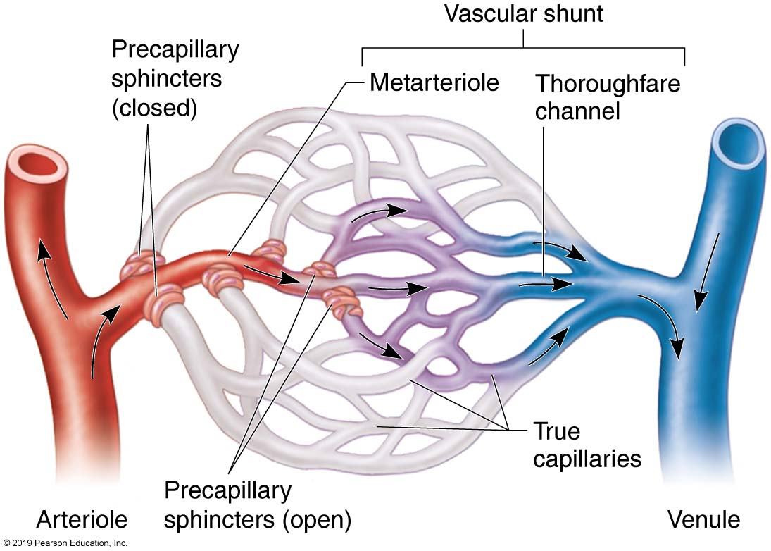
Arterioles
Metarterioles form branches into capillary bed
to bypass capillary bed, precapillary sphincters close & blood flows out of bed in thoroughfare channel
vasomotion is intermittent contraction & relaxation of sphincters that allow filling of capillary bed 5-10 times/minute

Slide 15
Venules
Small veins collecting blood from capillaries
Tunica media contains only a few smooth muscle cells & scattered fibroblasts
very porous endothelium allows for escape of many phagocytic white blood cells

Slide 16
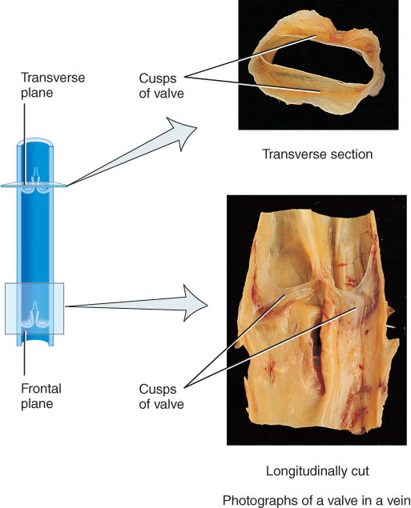
Veins
Proportionally thinner walls than same diameter artery
tunica media less muscle
lack external & internal elastic lamina
Valves are thin folds of tunica interna designed to prevent backflow
Capacitance vessels (blood reservoirs) that contain 65% of the blood supply

Slide 17
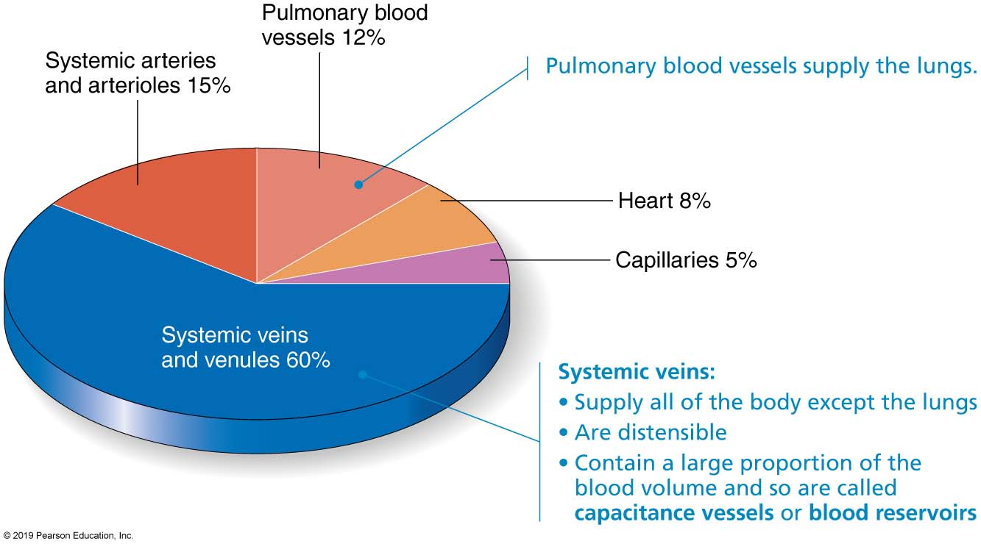
Relative proportion of blood volume throughout the cardiovascular system.

Slide 18
Venous System: Veins
Veins have much lower blood pressure and thinner walls than arteries
To return blood to the heart, veins have special adaptations
Large-diameter lumens, which offer little resistance to flow
Valves (resembling semilunar heart valves), which prevent backflow of blood
Venous sinuses – specialized, flattened veins with extremely thin walls (e.g., coronary sinus of the heart and dural sinuses of the brain)

Slide 19
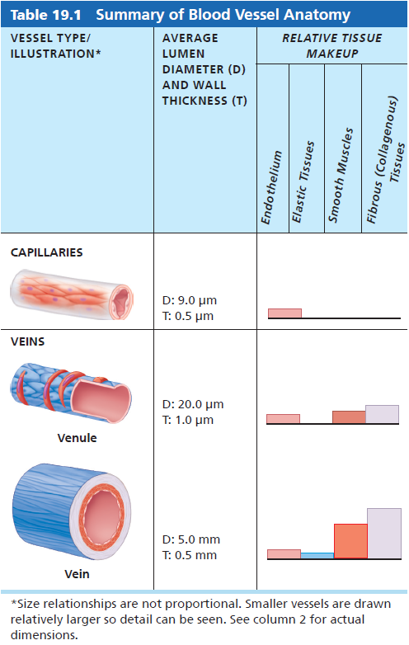
Summary of Blood Vessel Anatomy (capillaries, venules and veins)

Slide 20
Differences Between Arteries and Veins
 | Arteries | Veins
Delivery | Blood pumped into single systemic artery – the aorta | Blood returns via superior and interior venae cavae and the coronary sinus
Location | Deep, and protected by tissue | Both deep and superficial
Pathways | Fair, clear, and defined | Convergent interconnections
Supply/drainage | Predictable supply | Dural sinuses and hepatic portal circulation

Slide 21
Vascular Anastomoses
Merging blood vessels, more common in veins than arteries
Arterial anastomoses provide alternate pathways (collateral channels) for blood to reach a given body region
If one branch is blocked, the collateral channel can supply the area with adequate blood supply

Slide 22
Part 2 Physiology of Circulation
19.6 Flow, Pressure, and Resistance
Definition of Terms
Blood flow: volume of blood flowing through vessel, organ, or entire circulation in given period
Measured in ml/min, it is equivalent to cardiac output (CO) for entire vascular system
Overall is relatively constant when at rest, but at any given moment, varies at individual organ level, based on needs

Slide 23
Blood Pressure (BP)
Force per unit area exerted on the wall of a blood vessel by its contained blood
Expressed in millimeters of mercury (mm Hg)
The differences in BP within the vascular system provide the driving force that keeps blood moving from higher to lower pressure areas

Slide 24
Resistance
Resistance – opposition to flow
Measure of the amount of friction blood encounters
Generally encountered in the systemic circulation
Referred to as peripheral resistance (PR)
The three important sources of resistance are blood viscosity, total blood vessel length, and blood vessel diameter

Slide 25
Resistance Factors: Viscosity and Vessel Length
Resistance factors that remain relatively constant are:
Blood viscosity – “stickiness” of the blood
Blood vessel length – the longer the vessel, the greater the resistance encountered

Slide 26

Resistance Factors: Blood Vessel Diameter
Changes in vessel diameter are frequent and significantly alter peripheral resistance
Resistance varies inversely with the fourth power of vessel radius
For example, if the radius is doubled, the resistance is 1/16 as much

Slide 27
Resistance Factors: Blood Vessel Diameter
Small-diameter arterioles are the major determinants of peripheral resistance
Fatty plaques from atherosclerosis:
Cause turbulent blood flow
Dramatically increase resistance due to turbulence

Slide 28
Blood Flow, Blood Pressure, and Resistance
Blood flow (F) is directly proportional to the difference in blood pressure (ΔP) between two points in the circulation
If ΔP increases, blood flow speeds up; if ΔP decreases, blood flow declines

Slide 29
Systemic Blood Pressure
Systemic pressure:
Is highest in the aorta
Declines throughout the length of the pathway
Is 0 mm Hg in the right atrium
The steepest change in blood pressure occurs in the arterioles

Slide 30
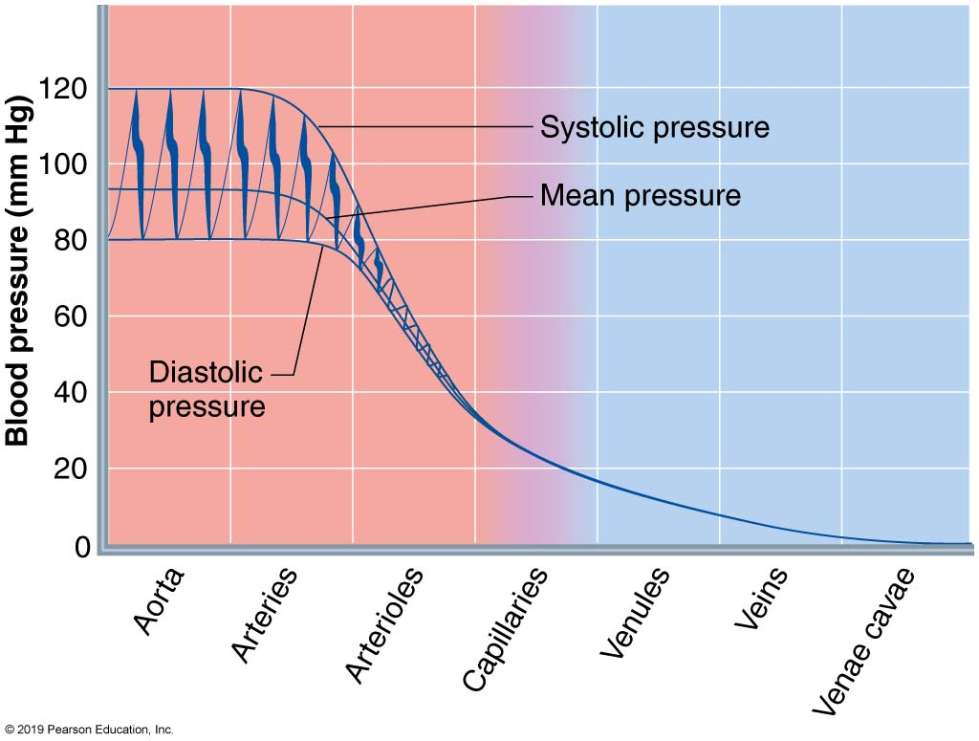
Systemic Blood Pressure: graphic

Slide 31
Arterial Blood Pressure
Systolic pressure – pressure exerted on arterial walls during ventricular contraction
Diastolic pressure – lowest level of arterial pressure during a ventricular cycle
Pulse pressure – the difference between systolic and diastolic pressure
Mean arterial pressure (MAP) – pressure that propels the blood to the tissues
MAP = diastolic pressure + 1/3 pulse pressure

Slide 32
Arterial Blood Pressure (cont.)
Clinical monitoring of circulatory efficiency
Vital signs: pulse and blood pressure, along with respiratory rate and body temperature
Taking a pulse
Radial pulse (taken at the wrist): most routinely used, but there are other clinically important pulse points
Pressure points: areas where arteries are close to body surface
Can be compressed to stop blood flow in event of hemorrhaging

Slide 33
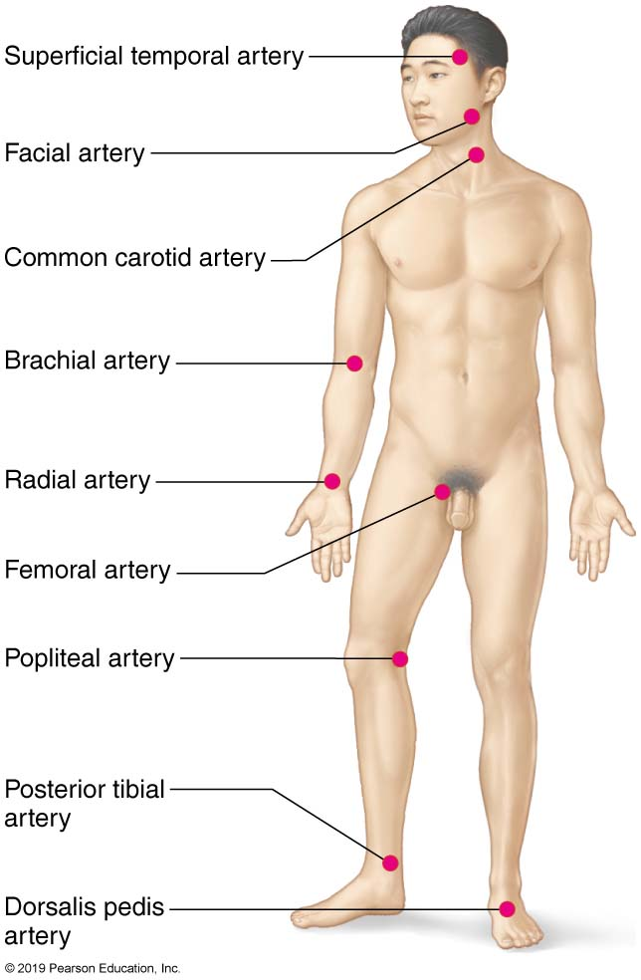
Body sites where the pulse is most easily palpated.

Slide 34
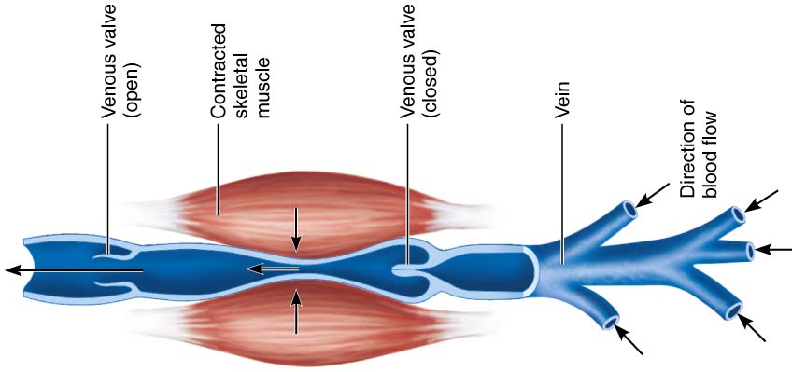
Factors Aiding Venous Return
Venous BP alone is too low to promote adequate blood return and is aided by the:
Respiratory “pump” – pressure changes created during breathing suck blood toward the heart by squeezing local veins
Muscular “pump” – contraction of skeletal muscles “milk” blood toward the heart
Valves prevent backflow during venous return

Slide 35
Maintaining Blood Pressure
The main factors influencing blood pressure are:
Cardiac output (CO)
Peripheral resistance (PR)
Blood volume
Blood pressure = CO x PR
Blood pressure varies directly with CO, PR, and blood volume

Slide 36
Controls of Blood Pressure
Short-term controls:
Are mediated by the nervous system and bloodborne chemicals
Counteract moment-to-moment fluctuations in blood pressure by altering peripheral resistance
Long-term controls regulate blood volume

Slide 37
19.8 Regulation of Blood Pressure
Factors can be affected by:
Short-term regulation: neural controls
Short-term regulation: hormonal controls
Long-term regulation: renal controls

Slide 38
Short-Term Mechanisms: Vasomotor Center
Vasomotor center – a cluster of sympathetic neurons in the medulla that oversees changes in blood vessel diameter
Maintains blood vessel tone by innervating smooth muscles of blood vessels, especially arterioles
Cardiovascular center – vasomotor center plus the cardiac centers that integrate blood pressure control by altering cardiac output and blood vessel diameter

Slide 39
Short-Term Mechanisms: Vasomotor Activity
Sympathetic activity causes:
Vasoconstriction and a rise in BP if increased
BP to decline to basal levels if decreased
Vasomotor activity is modified by:
Baroreceptors (pressure-sensitive)
chemoreceptors (O₂, CO₂, and H⁺ sensitive)
higher brain centers
bloodborne chemicals
hormones

Slide 40
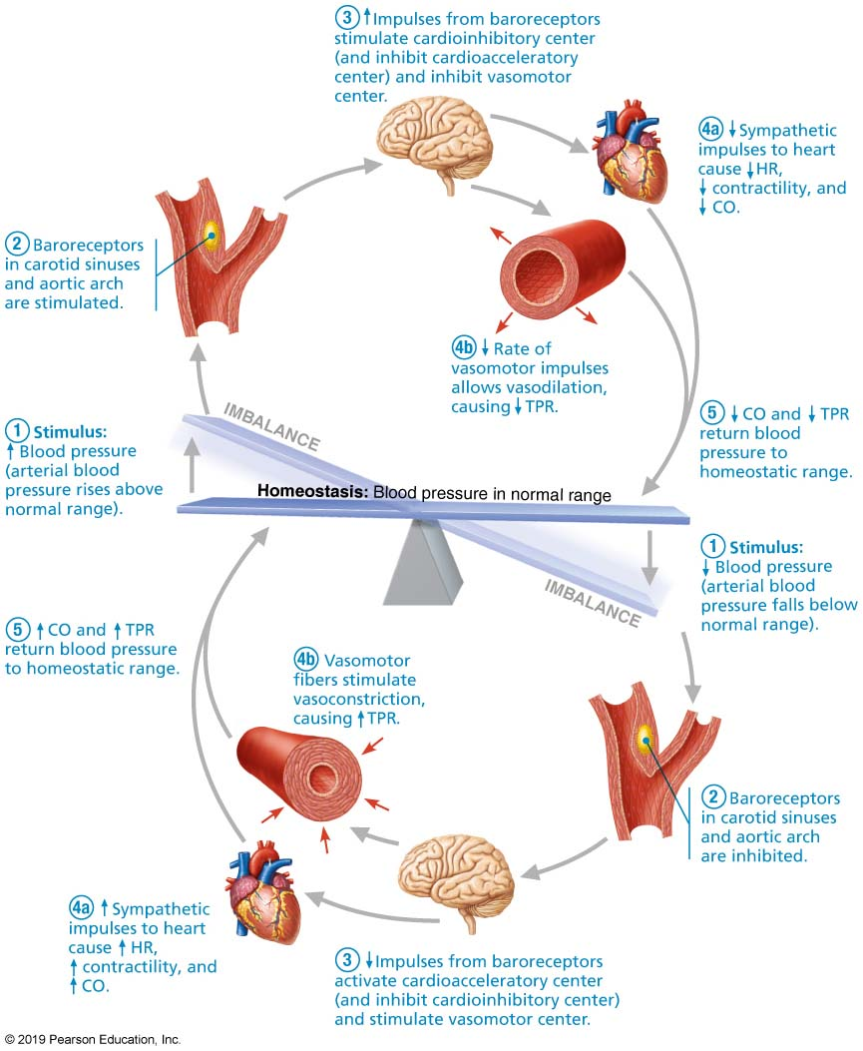
Baroreceptor Reflexes that Help Maintain Blood Pressure Homeostasis

Slide 41
Short-Term Mechanisms: Chemical Controls
Blood pressure is regulated by chemoreceptor reflexes sensitive to oxygen and carbon dioxide
Prominent chemoreceptors are in the carotid and aortic bodies
Reflexes that regulate BP are integrated in the medulla
Higher brain centers (cortex and hypothalamus) can modify BP via relays to medullary centers

Slide 42
Chemicals that Increase Blood Pressure
Adrenal medulla hormones – norepinephrine and epinephrine increase blood pressure
Antidiuretic hormone (ADH) – causes intense vasoconstriction in cases of extremely low BP
Angiotensin II – kidney release of renin generates angiotensin II, which causes vasoconstriction
Endothelium-derived factors – endothelin and prostaglandin-derived growth factor (PDGF) are both vasoconstrictors

Slide 43
Chemicals that Decrease Blood Pressure
Atrial natriuretic peptide (ANP) – causes blood volume and pressure to decline
Nitric oxide (NO) – is a brief but potent vasodilator
Inflammatory chemicals – histamine, prostacyclin, and kinins are potent vasodilators
Alcohol – causes BP to drop by inhibiting ADH

Slide 44
Long-Term Mechanisms: Renal Regulation
Long-term mechanisms control BP by altering blood volume
Baroreceptors adapt to chronic high or low BP
Increased BP stimulates the kidneys to eliminate water, thus reducing BP
Decreased BP stimulates the kidneys to increase blood volume and BP
*In 2006, a new technique was developed called carotid baroreceptor therapy to reduce hypertension (similar to a pacemaker)

Slide 45
Long-Term Mechanisms: Renal Regulation (cont.)
Direct renal mechanism
Alters blood volume independently of hormones
Increased BP or blood volume causes elimination of more urine, thus reducing BP
Decreased BP or blood volume causes kidneys to conserve water, and BP rises

Slide 46
Long-Term Mechanisms: Renal Regulation pt 3
Indirect mechanism
The renin-angiotensin-aldosterone mechanism
Decreased arterial blood pressure causes release of renin from kidneys
Renin enters blood and catalyzes conversion of angiotensinogen from liver to angiotensin I
Angiotensin-converting enzyme, especially from lungs, converts angiotensin I to angiotensin II

Slide 47
Measuring Blood Pressure
Systemic arterial BP is measured indirectly with the auscultatory method
A sphygmomanometer is placed on the arm superior to the elbow
Pressure is increased in the cuff until it is greater than systolic pressure in the brachial artery
Pressure is released slowly and the examiner listens with a stethoscope

Slide 48
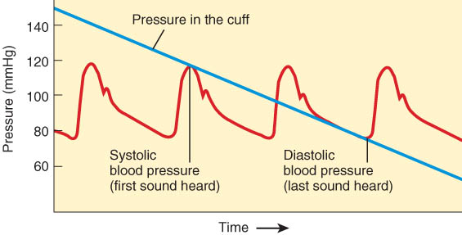
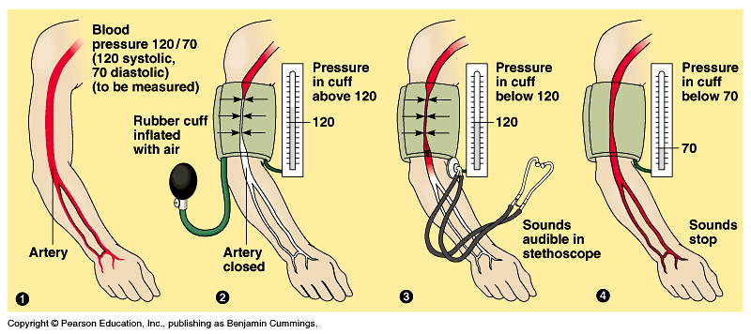
Evaluating Circulation

Slide 49
Alterations in Blood Pressure
Hypotension – low BP in which systolic pressure is below 100 mm Hg
Hypertension – condition of sustained elevated arterial pressure of 140/90 or higher

Slide 50
Hypotension
Orthostatic hypotension – temporary low BP and dizziness when suddenly rising from a sitting or reclining position
Chronic hypotension – hint of poor nutrition and warning sign for Addison’s disease
Acute hypotension – important sign of circulatory shock

Slide 51
Hypertension
Hypertension maybe transient or persistent
Primary or essential hypertension – risk factors in primary hypertension include diet, obesity, age, race, heredity, stress, and smoking
Secondary hypertension – due to identifiable disorders, including excessive renin secretion, arteriosclerosis, and endocrine disorders

Slide 52
Blood Flow Through Tissues
Blood flow, or tissue perfusion, is involved in:
Delivery of oxygen and nutrients to, and removal of wastes from, tissue cells
Gas exchange in the lungs
Absorption of nutrients from the digestive tract
Urine formation by the kidneys
Blood flow is precisely the right amount to provide proper tissue function

Slide 53
Velocity of Blood Flow
Blood velocity:
Changes as it travels through the systemic circulation
Is inversely proportional to the cross-sectional area
Slow capillary flow allows adequate time for exchange between blood and tissues

Slide 54
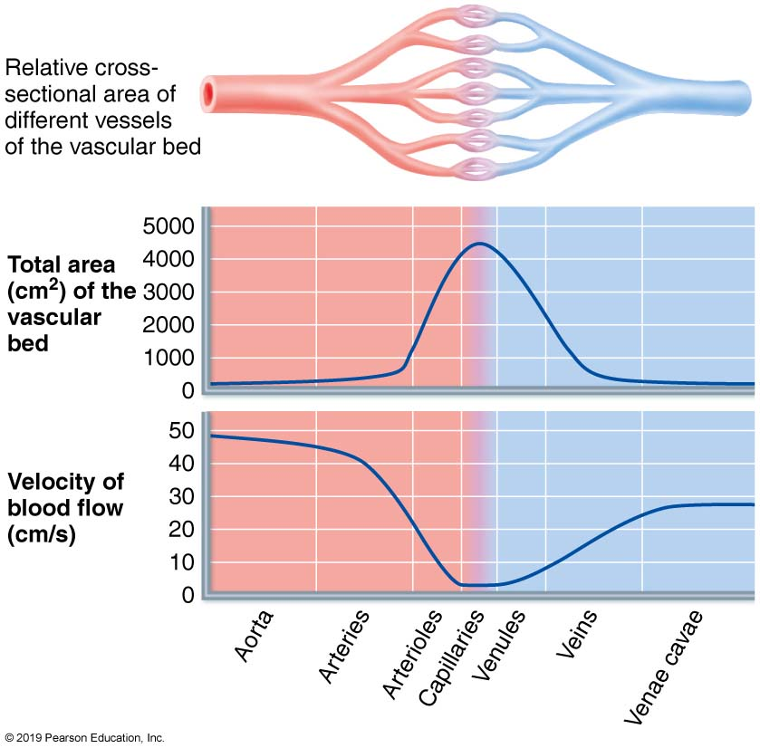
Velocity of Blood Flow: graphic

Slide 55
BIG TOPIC: control of blood pressure
Extrinsic control
Nervous control (ANS)
Sympathetic (mainly)
Hormonal control (endocrine and renal)
Epinephrine
ADH
Aldosterone
Intrinsic control (autoregulation)

Slide 56
Autoregulation: Local Regulation of Blood Flow
Autoregulation – automatic adjustment of blood flow to each tissue in proportion to its requirements at any given point in time
Blood flow through an individual organ is intrinsically controlled by modifying the diameter of local arterioles feeding its capillaries
MAP remains constant, while local demands regulate the amount of blood delivered to various areas according to need

Slide 57
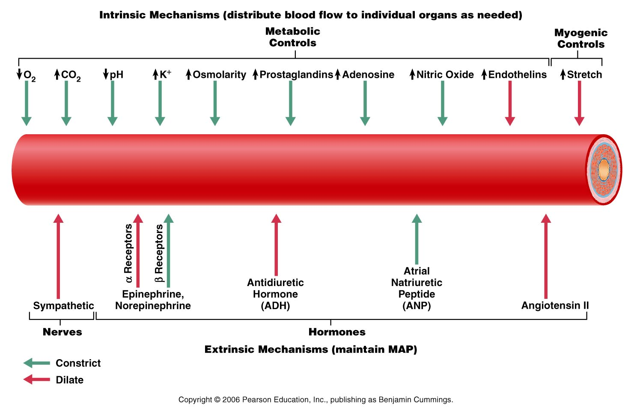
Control of Arteriolar Smooth Muscle
Dilate*
Constrict
Figure 19.14

Slide 58
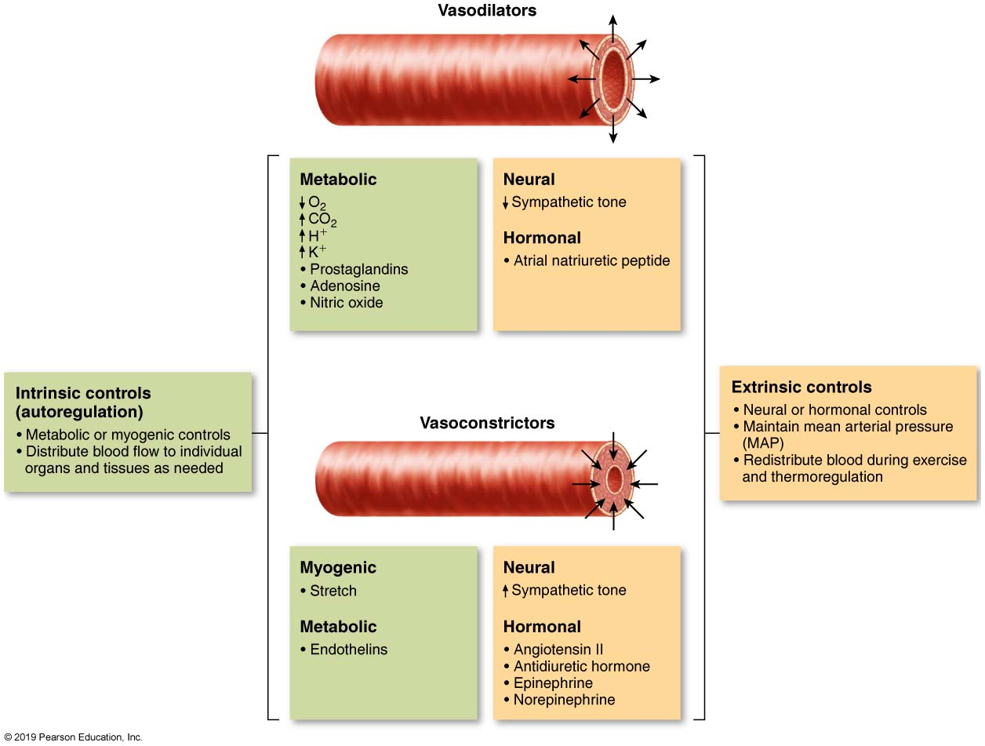
Control of arteriolar diameter

Slide 59
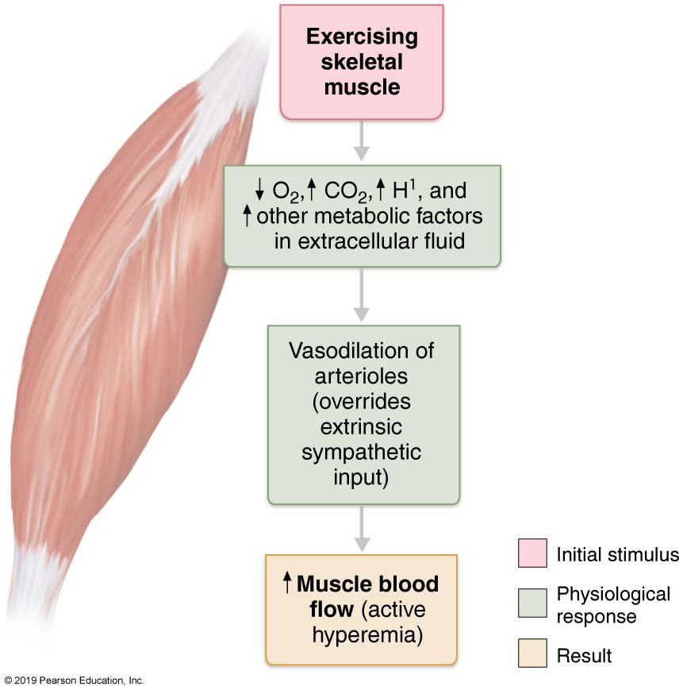
Active hyperemia

Slide 60
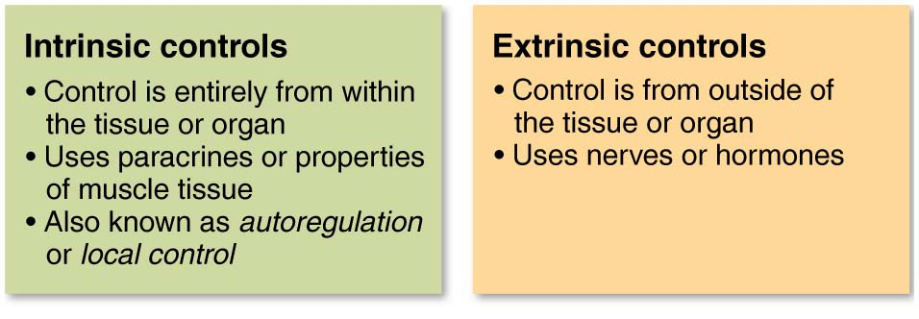
A Quick Summary of Intrinsic Versus Extrinsic Control Mechanisms

Slide 61
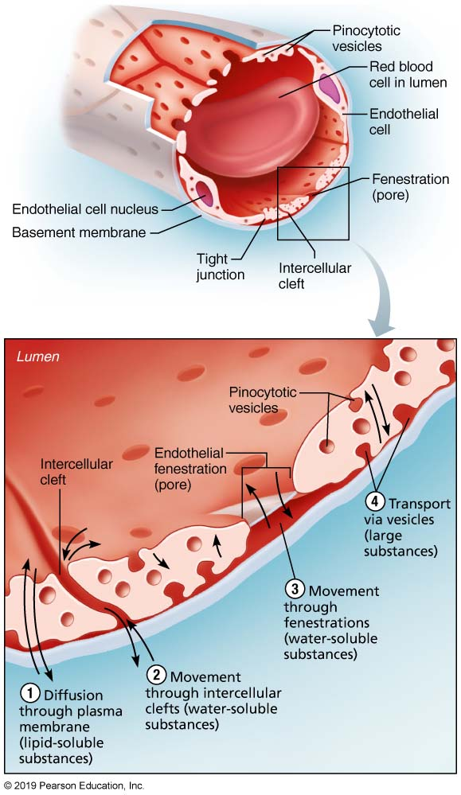
BIG TOPIC: Capillary Exchange
Oxygen, carbon dioxide, nutrients, and metabolic wastes diffuse between the blood and interstitial fluid along concentration gradients

Slide 62
Capillary Blood Pressure
Ranges from 35 mm Hg at beginning of capillary bed to ∼17 mm Hg at the end of the bed
Low capillary pressure is desirable because:
High BP would rupture fragile, thin-walled capillaries
Most capillaries are very permeable, so low pressure forces filtrate into interstitial spaces

Slide 63
Capillary Exchange of Respiratory Gases and Nutrients

Slide 64
Capillary Exchange: Bulk flow
Direction and amount of fluid flow depends upon the difference between:
Capillary hydrostatic pressure (HP_{c})
Capillary colloid osmotic pressure (OP_{c})
HP_{c} – pressure of blood against the capillary walls:
Tends to force fluids through the capillary walls
Is greater at the arterial end of a bed than at the venule end
OP_{c}– created by nondiffusible plasma proteins, which draw water toward themselves

Slide 65
Net Filtration Pressure (NFP)
NFP – all the forces acting on a capillary bed
NFP = (HP_{c} – HP_{if}) – (OP_{c} – OP_{if})
At the arterial end of a bed, hydrostatic forces dominate (fluids flow out)

Slide 66
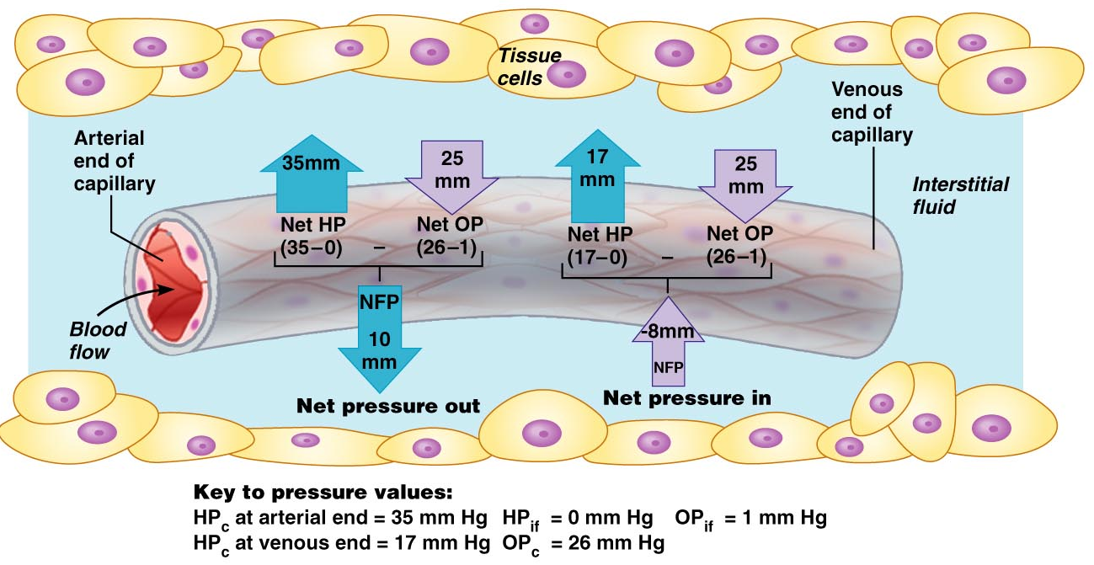
Bulk flow: graphic
Figure 19.16

Slide 67
Circulatory Shock
Circulatory shock – any condition in which blood vessels are inadequately filled and blood cannot circulate normally
Results in inadequate blood flow to meet tissue needs

Slide 68
Circulatory Shock: types
Three types include:
Hypovolemic shock – results from large-scale blood loss
Vascular shock – poor circulation resulting from extreme vasodilation
Cardiogenic shock – the heart cannot sustain adequate circulation

Slide 69
Circulatory Pathways
The vascular system has two distinct circulations
Pulmonary circulation – short loop that runs from the heart to the lungs and back to the heart
Systemic circulation – routes blood through a long loop to all parts of the body and returns to the heart

Slide 70
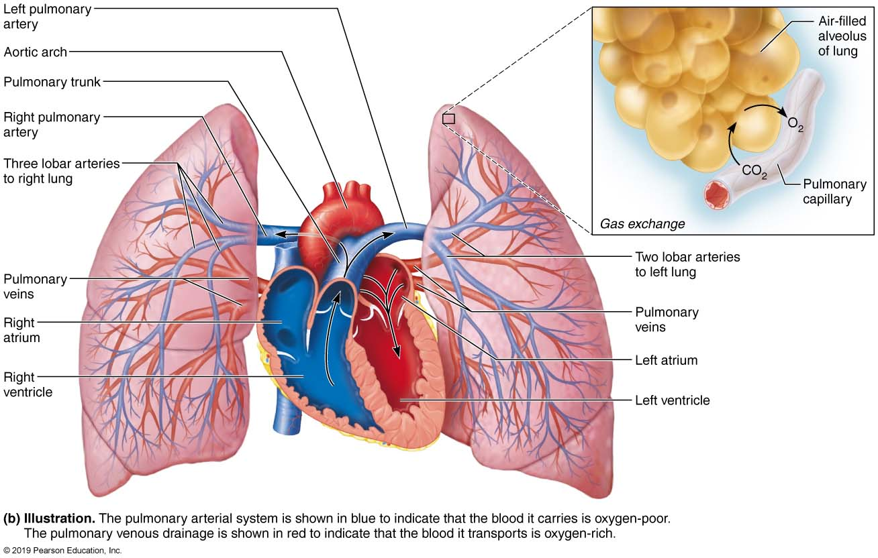
Pulmonary Circulation

Slide 71
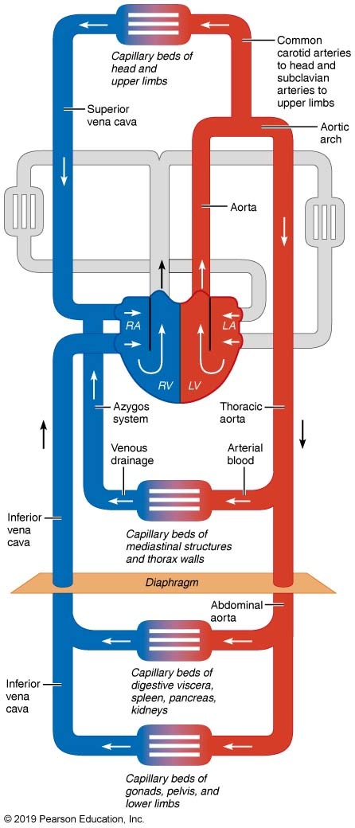
Systemic Circulation

Slide 72
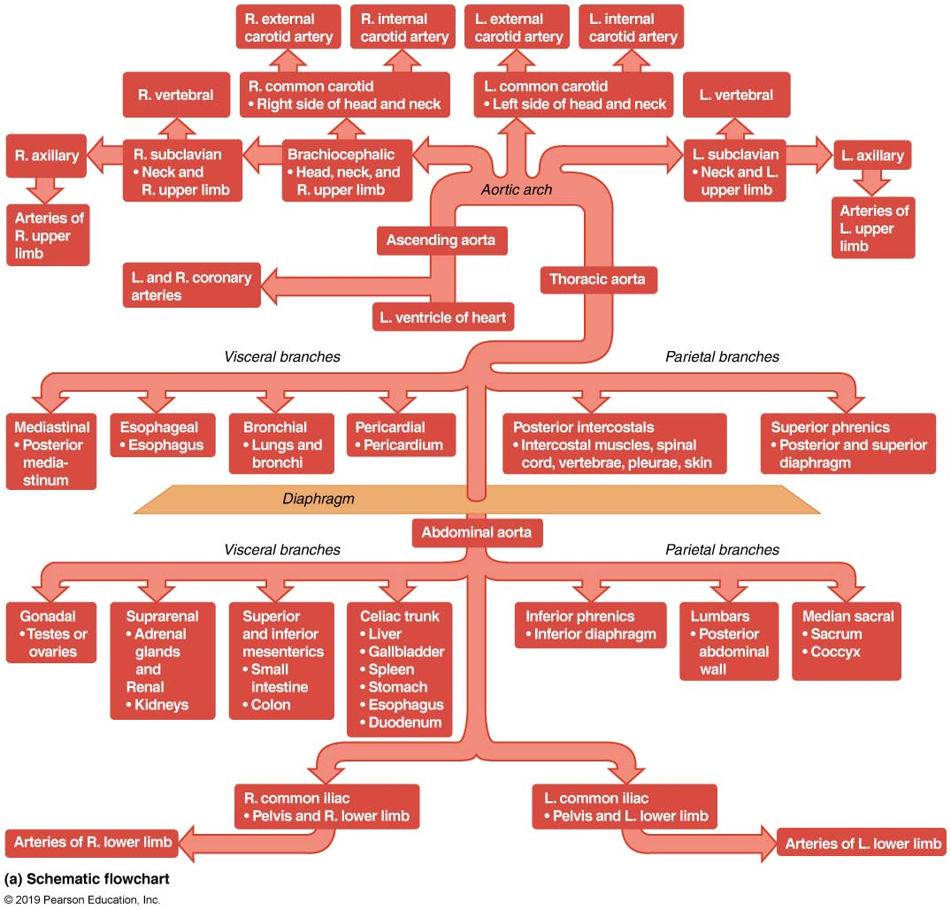
Major Arteries of the Systemic Circulation (1 of 2)
Figure 19.23a Major arteries of the systemic circulation.

Slide 73
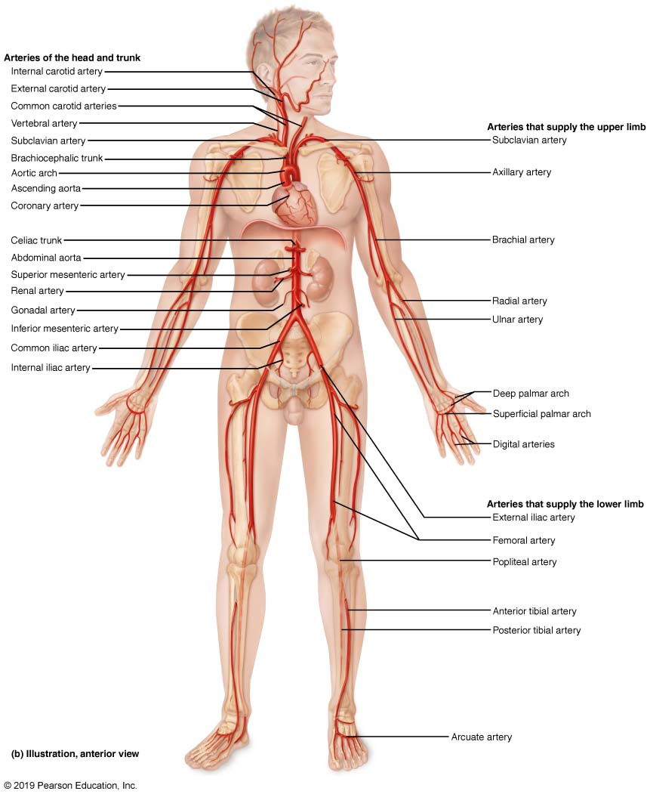
Major Arteries of the Systemic Circulation

Slide 74
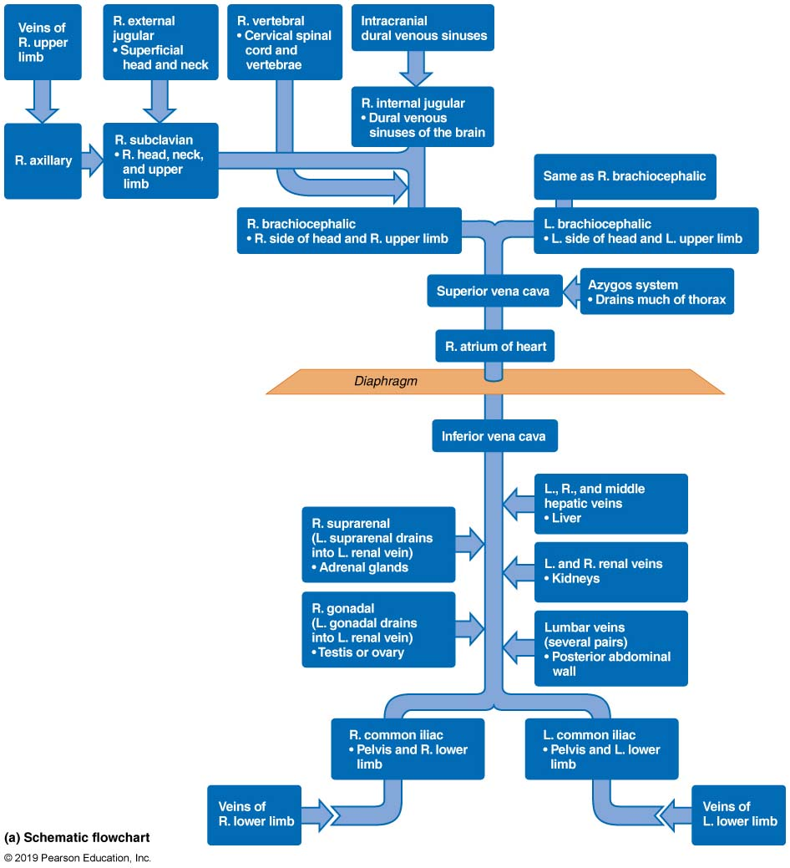
Major Veins of the Systemic Circulation (1 of 2)

Slide 75
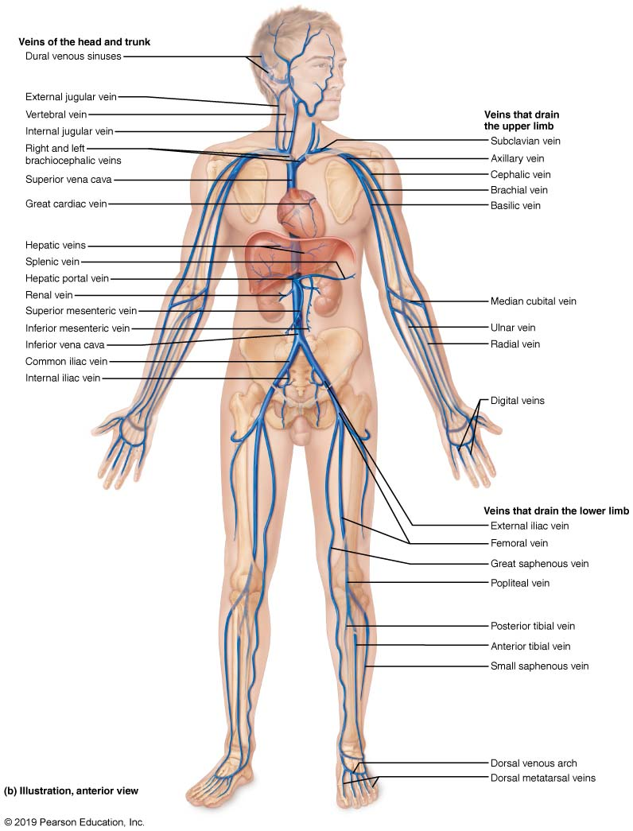
Major Veins of the Systemic Circulation (2 of 2)

Slide 76
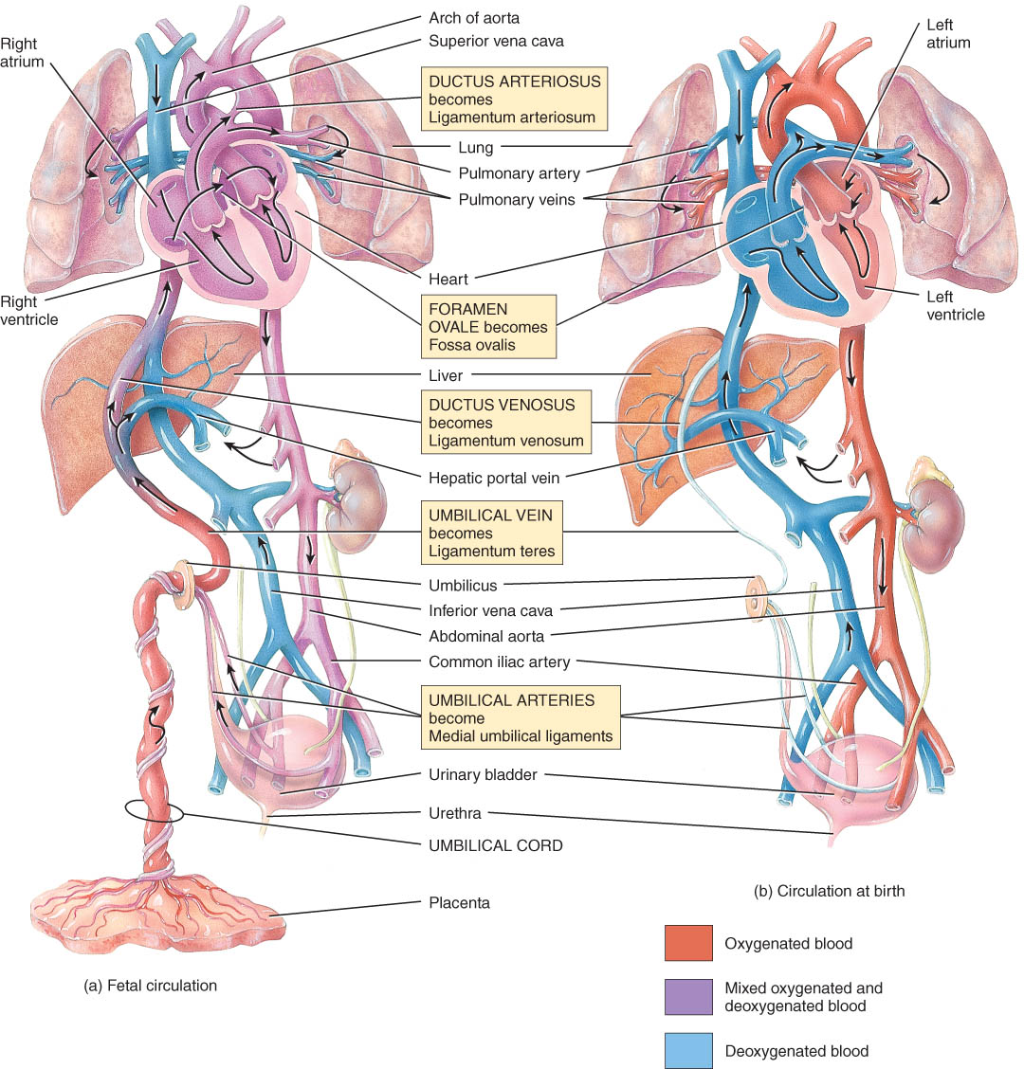
BIG TOPIC: Fetal Circulation
Oxygen from placenta reaches heart via fetal veins in umbilical cord.
bypasses liver
Umbilical aa. Branch off iliac aa. to return blood to placenta.

Slide 77
Fetal cardiovascular adaptations
Ductus arteriosus- a short vessel that connects the aorta and the pulmonary trunk to allow blood to enter systemic circulation (becomes the ligamentum arteriosum)
Ductus venosus- bypasses the liver
Foramen ovale- an opening that allows blood to be shunted directly from the right atrium to the left atrium, bypassing the lungs
Umbilical veins- brings oxygenated blood to the fetus through the umbilical cord
Umbilical arteries- brings blood away from the fetus through the umbilical cord

Slide 78
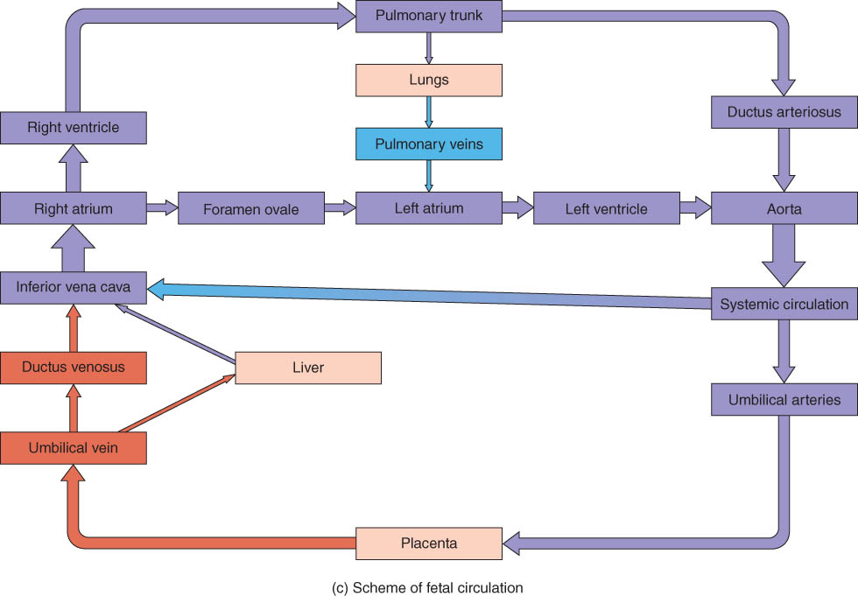
Lung Bypasses in Fetal Circulation
Ductus arteriosus is shortcut from pulmonary trunk to aorta bypassing the lungs.
Foramen ovale is shortcut from right atria to left atria bypassing the lungs.

